Slide 1
Built-in Objects

Slide 2
Built-in Objects
Number Object
Boolean Object
String Object
Array Object
Date Object
Math Object
RegEx Object

Slide 3
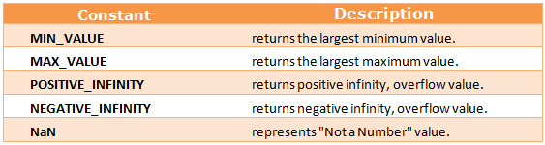
Number Object
var n=new Number(value);

Slide 4
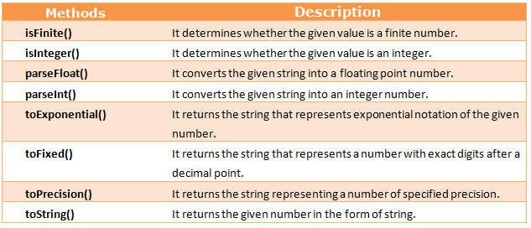
Number Object

Slide 5
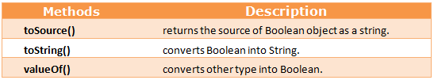
Boolean Object
Boolean b=new Boolean(value);

Slide 6
String Object
var stringname="string value"; //literal
var stringname=new String("string literal"); //Object

Slide 7
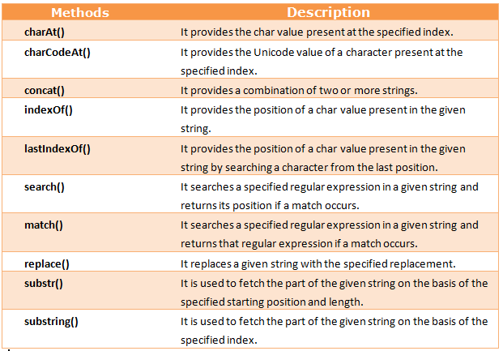
String Object

Slide 8
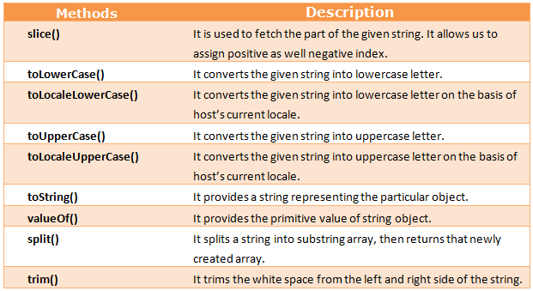
String Object

Slide 9
Date Object
Date()
Date(milliseconds)
Date(dateString)
Date(year, month, day, hours, minutes, seconds, milliseconds)

Slide 10
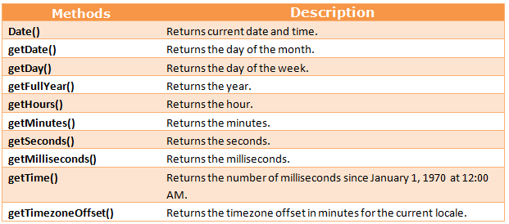
Date Object

Slide 11
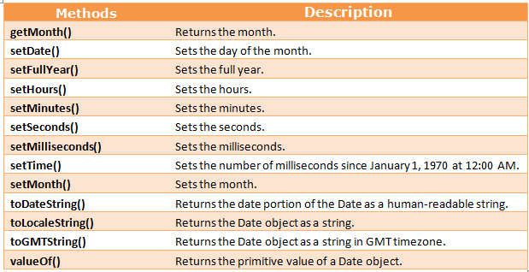
Date Object

Slide 12
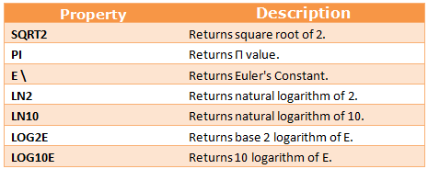
Math Object

Slide 13
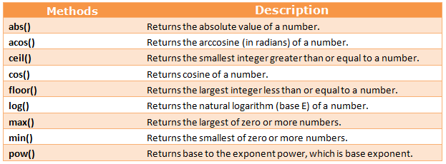
Math Object

Slide 14
REFERENCE
https://www.tutorialride.com/javascript/javascript-built-in-objects.htm

Slide 15
JavaScript Regular Expressions
Regular Expressions, commonly known as "regex" or "RegExp", are a specially formatted text strings used to find patterns in text.
Regular expressions are one of the most powerful tools available today for effective and efficient text processing and manipulations.
For example, it can be used to verify whether the format of data
i.e. name, email, phone number, etc. entered by the user is correct or not, find or replace matching string within text content, and so on.

Slide 16
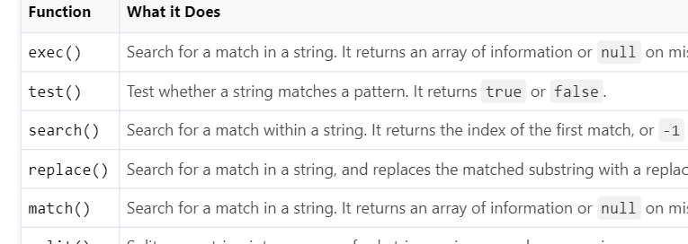

Slide 17
Defining Regular Expressions
In JavaScript, regular expressions are represented by RegExp object, which is a native JavaScript object like String, Array, and so on.
There are two ways of creating a new RegExp object — one is using the literal syntax, and the other is using the RegExp() constructor.

Slide 18
Syntax
The literal syntax uses forward slashes (/pattern/) to wrap the regular expression pattern, whereas the constructor syntax uses quotes ("pattern"). The following example demonstrates both ways of creating a regular expression that matches any string that begins with "Mr.".
// Literal syntax
var regex = /^Mr\./;
// Constructor syntax
var regex = new RegExp("^Mr\\.");

Slide 19
Pattern Matching with Regular Expression
Regular expression patterns include the use of letters, digits, punctuation marks, etc., plus a set of special regular expression characters (do not confuse with the HTML special characters).
The characters that are given special meaning within a regular expression, are:
. * ? + [ ] ( ) { } ^ $ | \.
You will need to backslash these characters whenever you want to use them literally. For example, if you want to match ".", you'd have to write \.. All other characters automatically assume their literal meanings.

Slide 20
Character Classes
Square brackets surrounding a pattern of characters are called a character class e.g. [abc]. A character class always matches a single character out of a list of specified characters that means the expression [abc] matches only a, b or c character.
Negated character classes can also be defined that match any character except those contained within the brackets. A negated character class is defined by placing a caret (^) symbol immediately after the opening bracket, like [^abc], which matches any character except a, b, and c.

Slide 21
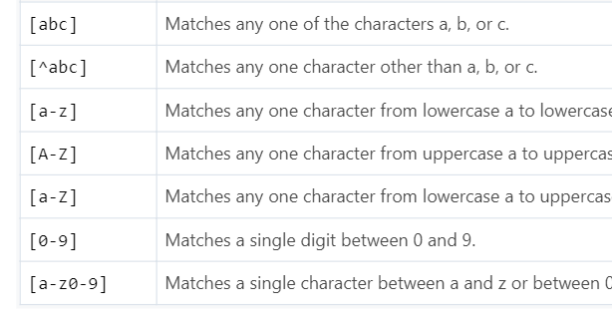

Slide 22
Predefined Character Classes
Some character classes such as digits, letters, and whitespaces are used so frequently that there are shortcut names for them. The following table lists those predefined character classes:

Slide 24
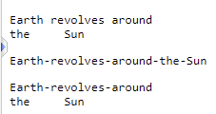
How to find and replace space with a hyphen character in a string using regular expression with the JavaScript replace() method: Example
var regex = /\s/g;
var replacement = "-";
var str = "Earth revolves around\nthe\tSun";
// Replace spaces, newlines and tabs
document.write(str.replace(regex, replacement) + "<hr>");
// Replace only spaces
document.write(str.replace(/ /g, "-"));

Slide 25
Repetition Quantifiers
if you want to match on more than one character? For example, let's say you want to find out words containing one or more instances of the letter p, or words containing at least two p's, and so on.
This is where quantifiers come into play. With quantifiers you can specify how many times a character in a regular expression should match. Quantifiers can be applied to the individual characters, as well as classes of characters, and groups of characters contained by the parentheses.

Slide 26
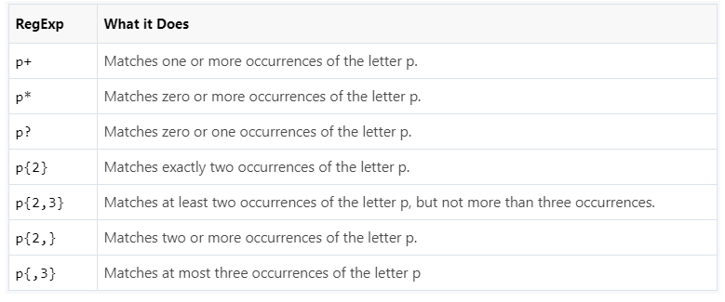

Slide 27

Example
var regex = /[\s,]+/;
var str = "My favourite colors are red, green and blue";
var parts = str.split(regex);
// Loop through parts array and display substrings
for(var part of parts){
document.write("<p>" + part + "</p>");
}

Slide 28
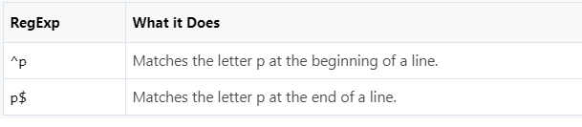
Position Anchors
There are certain situations where you want to match at the beginning or end of a line, word, or string. To do this you can use anchors. Two common anchors are caret (^) which represent the start of the string, and the dollar ($) sign which represent the end of the string.

Slide 29

Example
var regex = /^J/;
var names = ["James Bond", "Clark Kent", "John Rambo"];
// Loop through names array and display matched names
for(var name of names) {
if(regex.test(name)) {
document.write("<p>" + name + "</p>")
}
}

Slide 30
Pattern Modifiers (Flags)
A pattern modifier allows you to control the way a pattern match is handled. Pattern modifiers are placed directly after the regular expression, for example, if you want to search for a pattern in a case-insensitive manner, you can use the i modifier, like this: /pattern/i.

Slide 31
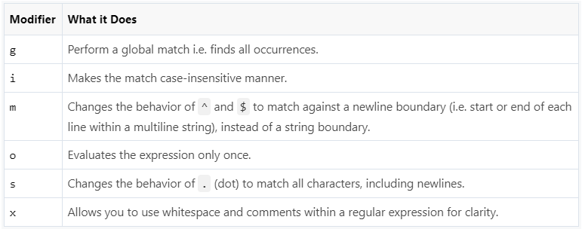

Slide 32

Example
var regex = /color/gi;
var str = "Color red is more visible than color blue in daylight.";
var matches = str.match(regex); // global, case-insensitive match
console.log(matches);
// expected output: ["Color", "color"]

Slide 33
Alternation
Alternation allows you to specify alternative version of a pattern. Alternation in a regular expression works just like the OR operator in an if-else conditional statement.
You can specify alternation using a vertical bar (|). For example, the regexp /fox|dog|cat/ matches the string "fox", or the string "dog", or the string "cat". Here's an example:

Slide 34

Example
var regex = /fox|dog|cat/;
var str = "The quick brown fox jumps over the lazy dog.";
var matches = str.match(regex);
console.log(matches);
// expected output: ["fox", index: 16, ...]

Slide 35
Grouping
Regular expressions use parentheses to group subexpressions, just like mathematical expressions. Parentheses allow a repetition quantifier to be applied to an entire subexpression.
For example, in regexp /go+/ the quantifier + is applied only to the last character o and it matches the strings "go", "goo", and so on. Whereas, in regexp /(go)+/ the quantifier + is applied to the group of characters g and o and it matches the strings "go", "gogo", and so on.

Slide 36
Example
var regex = /(go)+/i;
var str = "One day Gogo will go to school.";
var matches = str.match(regex); // case-insensitive match
console.log(matches);
// expected output: ["Gogo", "go", index: 8, ...]

Slide 37
Word Boundaries
A word boundary character ( \b) helps you search for the words that begins and/or ends with a pattern. For example, the regexp /\bcar/ matches the words beginning with the pattern car, and would match cart, carrot, or cartoon, but would not match oscar.
Similarly, the regexp /car\b/ matches the words ending with the pattern car, and would match oscar or supercar, but would not match cart. Likewise, the /\bcar\b/ matches the words beginning and ending with the pattern car, and would match only the word car.

Slide 38
Example
var regex = /(\bcar\w*)/g;
var str = "Words begining with car: cart, carrot, cartoon. Words ending with car: oscar, supercar.";
var replacement = '<b>$1</b>';
var result = str.replace(regex, replacement);
document.write(result);

Slide 39
Exception Handling

Slide 40
Introduction
Existence of an anomalous condition which requires special operable techniques signifies an exception
An exception is an abnormal code that breaks the regular flow of the code in programming terms
Such exceptions require specific programming constructs for its execution

Slide 41
Exception Handling
A process or method used for handling the anomalous statements in the code and executing them is termed as exception handling
It handles the flow control of the code/program
Various handlers are used that process the exception and execute the code for handling the code
For example, the Division of a non-zero value with zero will result into infinity always, and it is an exception.

Slide 42
Exception Handling
This situation can be executed and handled with the help of exception handling
The proper execution of the program may be disturbed by different types of errors

Slide 43
Types of Errors
There are three types of errors in the code:
Syntax Error: A syntax error may appear if there is any mistake in the pre-defined syntax of a programming language.
Runtime Error: When an error occurs during the execution of the program, such an error is known as Runtime error. The codes which create runtime errors are known as Exceptions. Thus, exception handlers are used for handling runtime errors.
Logical Error: Logical mistake in the program that may not produce the desired output, and may terminate unusually.

Slide 44
Error Object
Error object is created and thrown when a runtime error occurs. Such an object can be used as a base for the user-defined exceptions.
An error object has two properties:
name: This is an object property that sets or returns an error name
message: This property returns an error message in the string form

Slide 45
Standard built-in error types
Error is a generic constructor
Standard built-in error types or error constructors:
EvalError: It creates an instance for the error that occurred in the eval(), which is a global function used for evaluating the js string code
InternalError: When the js engine throws an internal error this instance is created
RangeError: When a numeric variable or parameter is out of its valid range instance for this error is created

Slide 46
Exception Handling Statements
There are following statements that handle if any exception occurs:
throw statements
try…catch statements
try…catch…finally statements

Slide 47
try…catch
Various programming languages use try…catch commonly
The error-prone part of the code is handled.
Initially the code is tested for all possible errors it may contain and to tackle those errors actions are taken
A good programming approach is to keep the complex code within the try…catch statements

Slide 48
Note
catch {} statement executes only after the execution of the try {} statement. Also, one try block can contain one or more catch blocks.

Slide 49
Syntax
try{ expression; } //code to be written.
catch(error){ expression; } // code for handling the error.

Slide 50
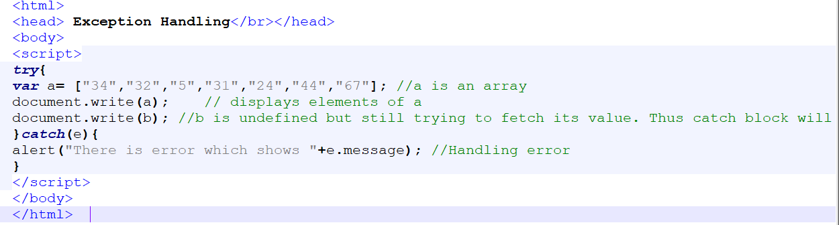
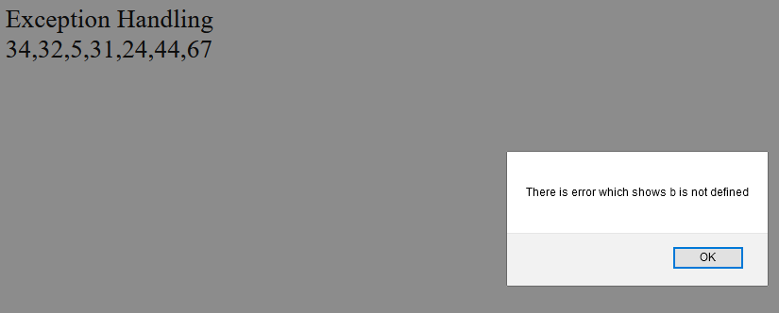
try…catch example

Slide 51
try{} statement
Try{} block holds the code which needs possible error testing is kept
It passes control to the catch{} block for taking suitable actions and handle the error in case any error occurs
Otherwise, it executes the code written within

Slide 52
catch{} statement
The error of the code is handled by this block by executing the set of statements written within the block
Contains either the user-defined exception handler or the built-in handler
When any error-prone code needs to be handled in the try block catch{} is initiated. Otherwise, the catch block is skipped

Slide 53
Throw Statement
User-defined errors are thrown by throw statements
User can define and throw their own custom errors
The statements present after the throw statement will not execute when throw statement is executed
The control will directly pass to the catch block
Syntax:
throw exception;

Slide 54
try…catch…throw syntax
try{
throw exception; // user can define their own exception
}
catch(error) {
expression; } // code for handling exception.
The exception can be a string, number, object, or boolean value
With the help of throw statement, users can create their own errors

Slide 55
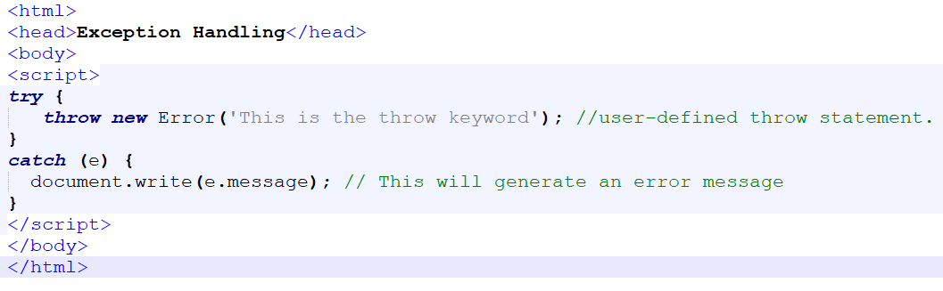

throw example with try…catch

Slide 56
finally statement
An optional block of statements which is executed after the execution of try and catch statements
Finally block does not hold for the exception to be thrown
Any exception is thrown or not, finally block code, if present, will definitely execute. It does not care for the output too.
Therefore, we can also use try/catch/throw/finally keyword together for handling complex code.

Slide 57
Syntax
try{
expression;
}
catch(error){
expression;
}
finally{
expression; } //Executable code

Slide 58
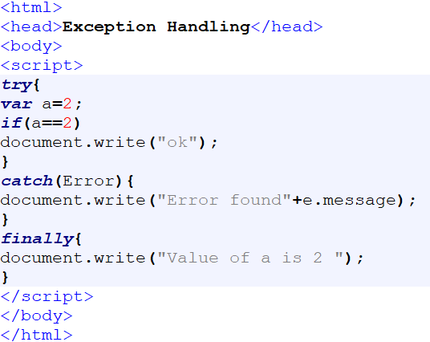

try…catch…finally example

Slide 59
Event Handling

Slide 60
Event?
Events occur when the user or the browser manipulates a page it’s how the JavaScript's interaction with HTML is handled
When a button is click it is an event. Also, when the page loads, it is called an event
Pressing any key, closing a window, resizing a window, etc are some examples of events

Slide 61
Event?
Events can be used to execute JavaScript coded responses, which cause buttons to close windows, messages to be displayed to users etc
Document Object Model (DOM) includes events
JavaScript code is triggered by HTML elements containing a set of events

Slide 62
onclick Event Type
This event occurs when a user clicks the left button of the mouse
In this event type we can put our validation, warning etc

Slide 63
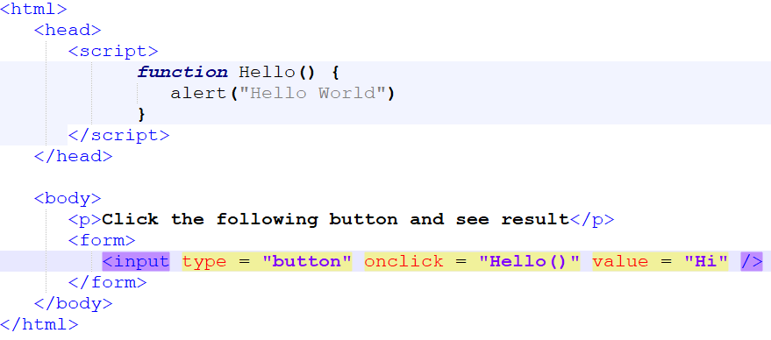
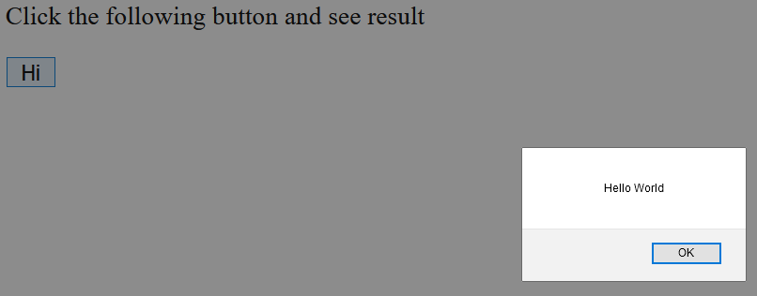
Example

Slide 64
onsubmit Event Type
An event that occurs when you try to submit a form is onsubmit
Form validation can be put your against this event type
Example
The following example uses onsubmit event
The form will be submitted if formvalidate() function returns true, otherwise it will not submit the data

Slide 65
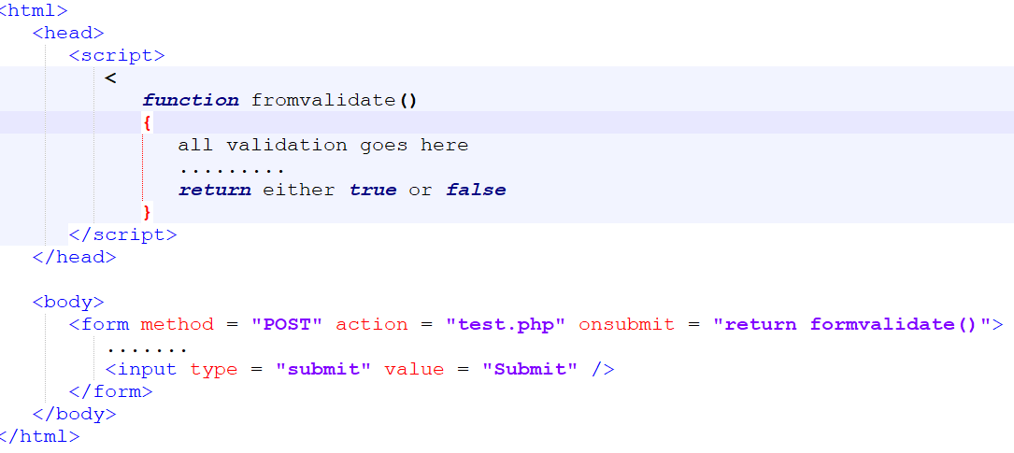
Example

Slide 66
onmouseover and onmouseout
These two event types will help you create nice effects with images or even with text as well
The event which is triggered when we bring our mouse over any element is onmouseover
The event which is triggered when we move our mouse out from that element is onmouseout

Slide 67
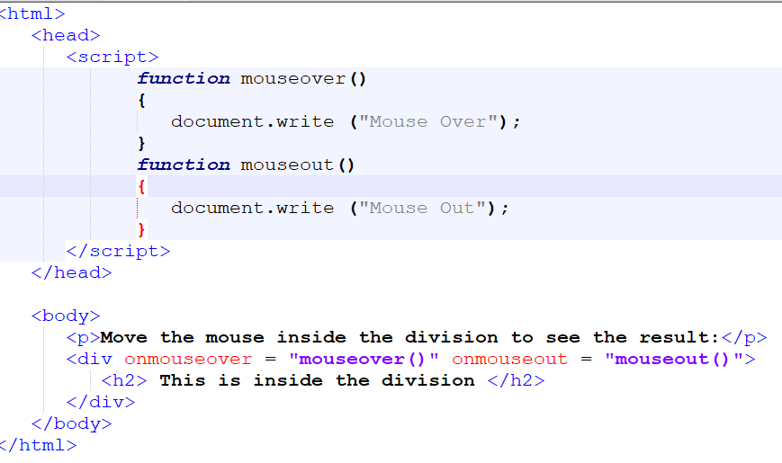
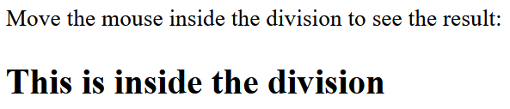


Slide 68
Standard Events
Some standard HTML 5 events are listed here. Here script indicates a JavaScript function to be executed against that event
Attribute | Value | Description
Onabort | script | Triggers on an abort event
onbeforeonload | script | Triggers before the document loads
onblur | script | Triggers when the window loses focus
onchange | script | Triggers when an element changes
ondblclick | script | Triggers on a mouse double-click

Slide 69
Standard Events
Attribute | Value | Description
ondragover | script | Triggers at the start of a drag operation
ondrop | script | Triggers when dragged element is being dropped
onemptied | script | Triggers when a media resource element suddenly becomes empty.
onerror | script | Triggers when an error occur
onfocus | script | Triggers when the window gets focus

Slide 70
JavaScript Validation

Slide 71
Form Validation
JavaScript does the HTML form validation
The function below alerts a message, and returns false, to prevent the form from being submitted when a form field (firstname) is empty
JavaScript Example
function formvalidate() { var a = document.forms["Form"]["firstname"].value; if (a == "") { alert("Name field is empty"); return false; } }

Slide 72
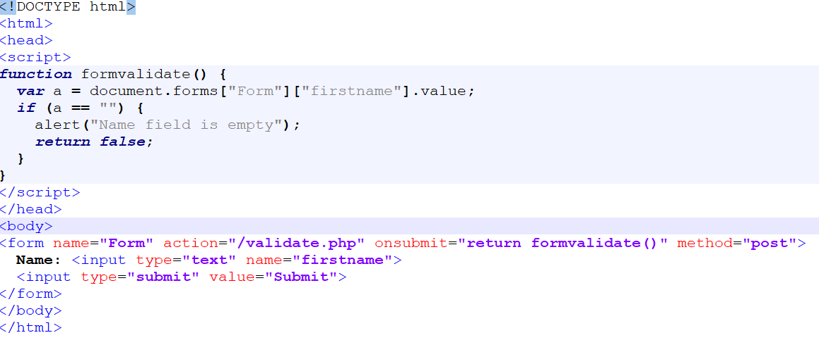
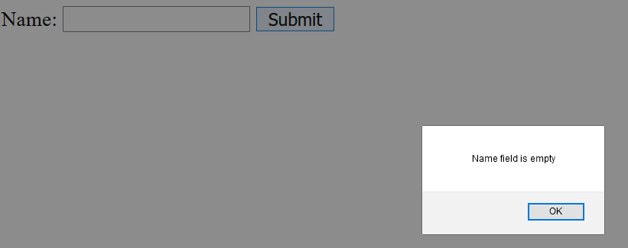
Validation example

Slide 73
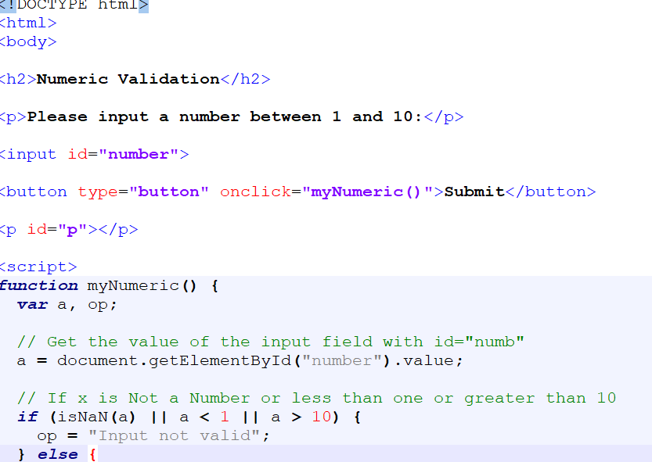
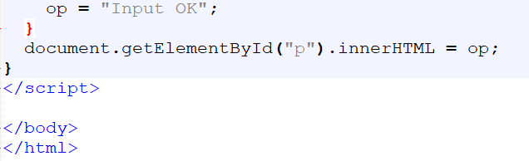
Numeric Validation

Slide 74
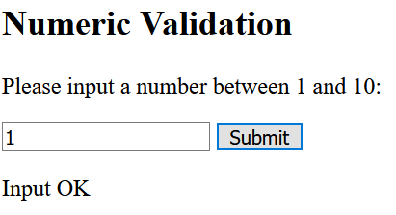
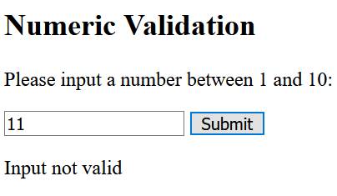
output

Slide 75
HTML Form Validation Automatic
The browser automatically performs form validation as follows:
If a form field (firstname) is empty, the required attribute prevents this form from being submitted
HTML Form Example
<form action="/validate.php" method="post"> <input type="text" name="firstname" required> <input type="submit" value="Submit"> </form>

Slide 76
Note
Internet Explorer 9 or earlier does not support Automatic HTML form validation

Slide 77
Data Validation
The process of ensuring that user input is clean, correct, and useful is termed Data Validation
Typical validation tasks are:
has all the required fields been filled?
has the user entered a valid date?
has the user entered text in a numeric field?
Correct user input is ensured by data validation

Slide 78
Validation types
Different methods can be used for validation and deployment can be done in many different ways
Server side validation is performed by a web server, after input has been sent to the server
Client side validation is performed by a web browser, before input is sent to a web server

Slide 79
Constraint Validation
A new HTML validation concept called constraint validation is introduced in HTML5
HTML constraint validation is based on:
Constraint validation HTML Input Attributes
Constraint validation CSS Pseudo Selectors
Constraint validation DOM Properties and Methods

Slide 80
Constraint Validation HTML Input Attributes
Attribute | Description
disabled | Specifies that the input element should be disabled
max | Specifies the maximum value of an input element
min | Specifies the minimum value of an input element
pattern | Specifies the value pattern of an input element
required | Specifies that the input field requires an element
type | Specifies the type of an input element

Slide 81
Constraint Validation CSS Pseudo Selectors
Selector | Description
:disabled | Selects input elements with the "disabled" attribute specified
:invalid | Selects input elements with invalid values
:optional | Selects input elements with no "required" attribute specified
:required | Selects input elements with the "required" attribute specified
:valid | Selects input elements with valid values

